Slide 1
Geometry and Measures
KAZIBA STEPHEN
02nd September 2024

Slide 2
Topics
Geometric Constructions Skills
Bearings
General and angle properties of geometric figures
Reflection
Business mathematics
Time and time tables
Similarities and enlargement
Circles
Rotation
Length and area properties of two- dimensional geometrical figures.
Nets, areas and volumes of solids
Trigonometry
Vectors
Matrix transformations
Circle properties
Lines and planes in three dimensions

Slide 3
Mensuration
A branch of mathematics that talks about the length, volume, or area of different geometric shapes is called Mensuration. These shapes exist either in 2-dimensions or 3-dimensions.

Slide 4
Geometric shapes in Real life

Slide 5
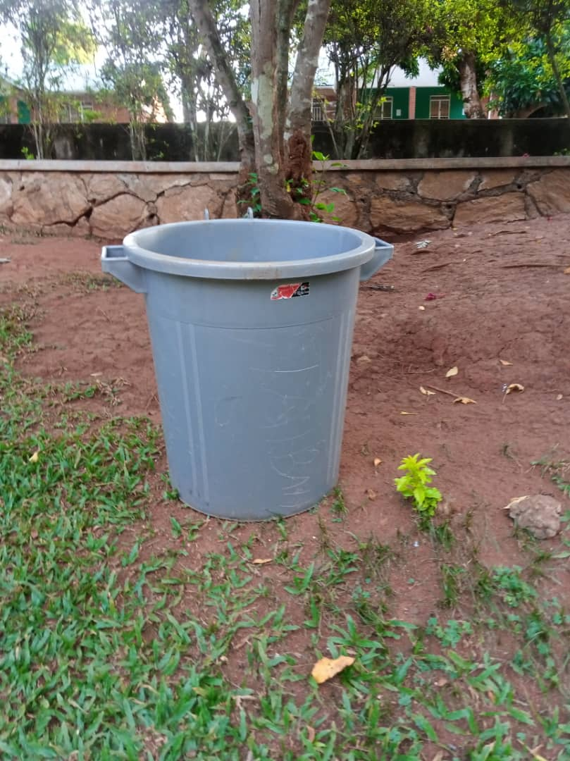
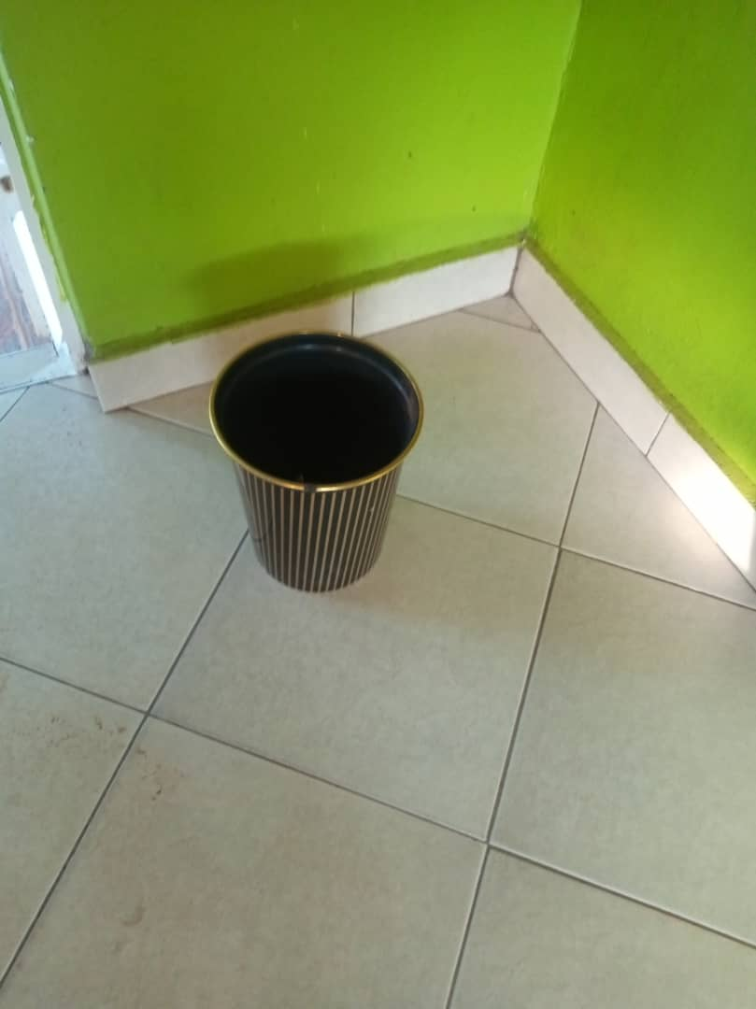
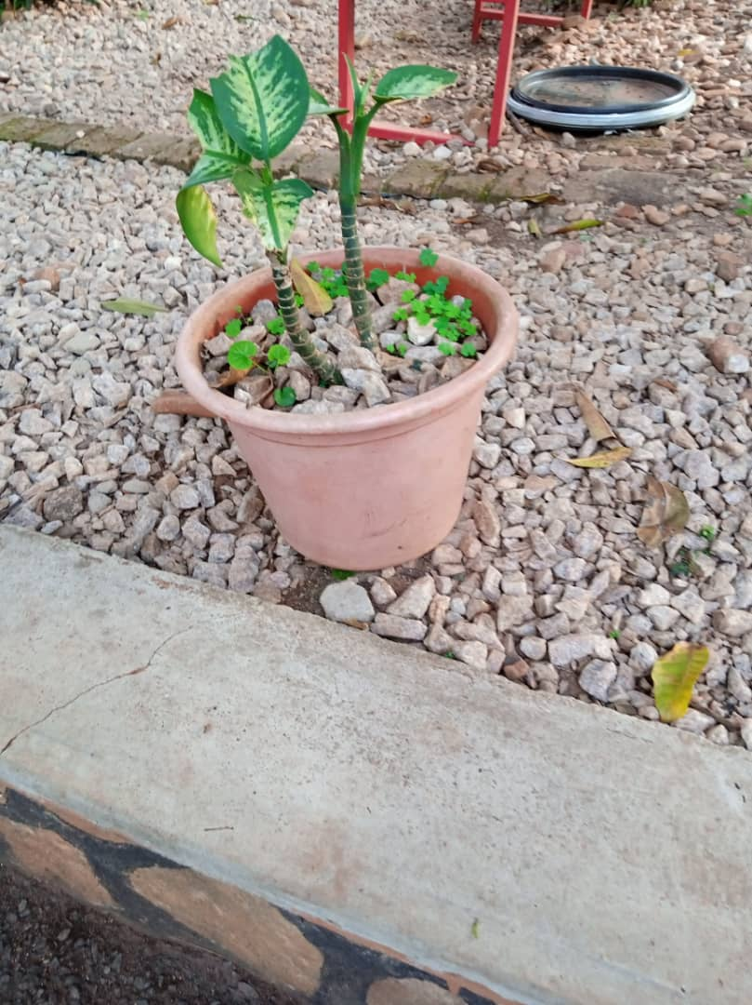

Slide 6
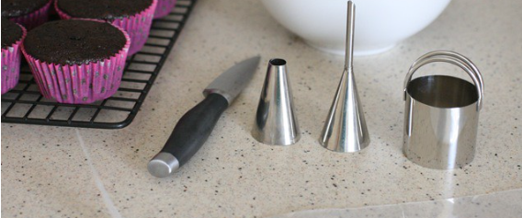

Slide 7
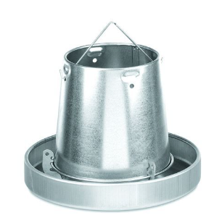
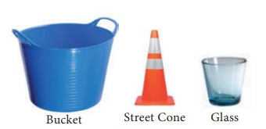

Slide 8
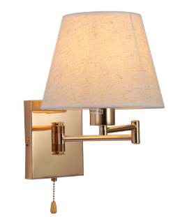
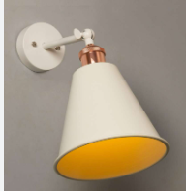

Slide 9
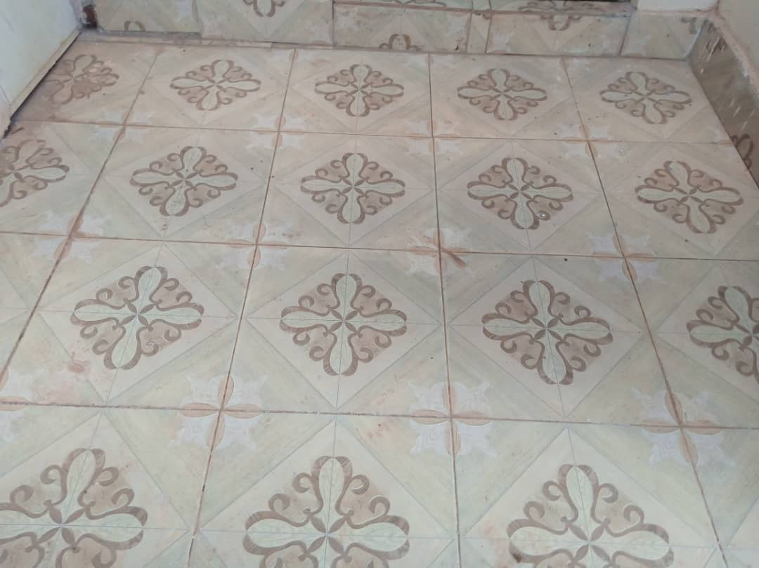
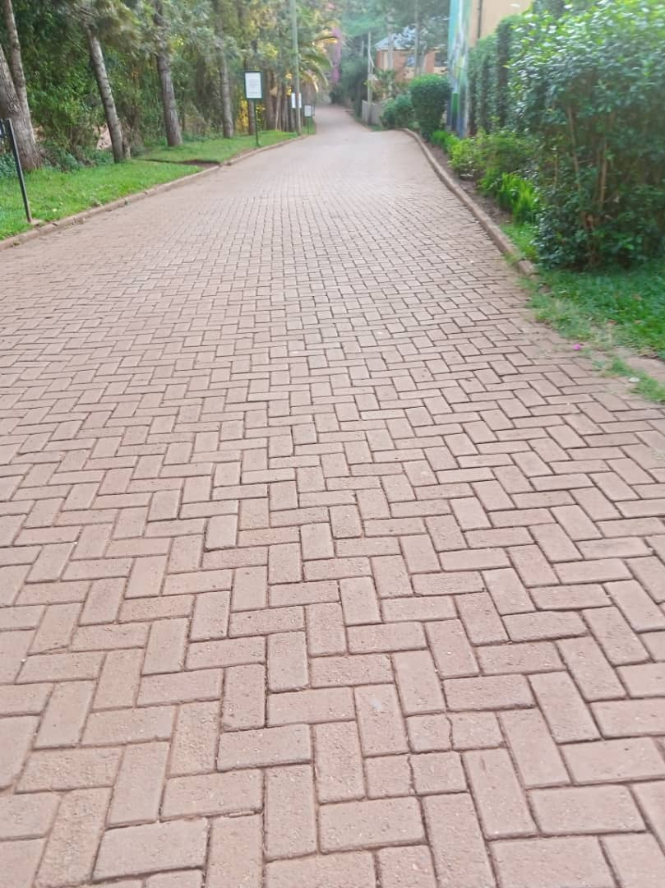
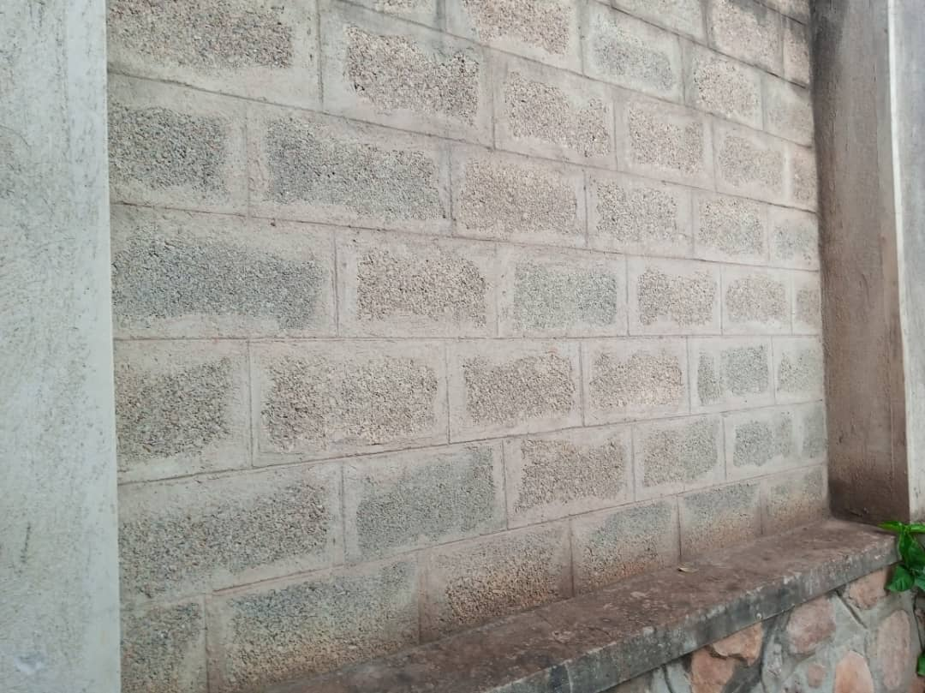
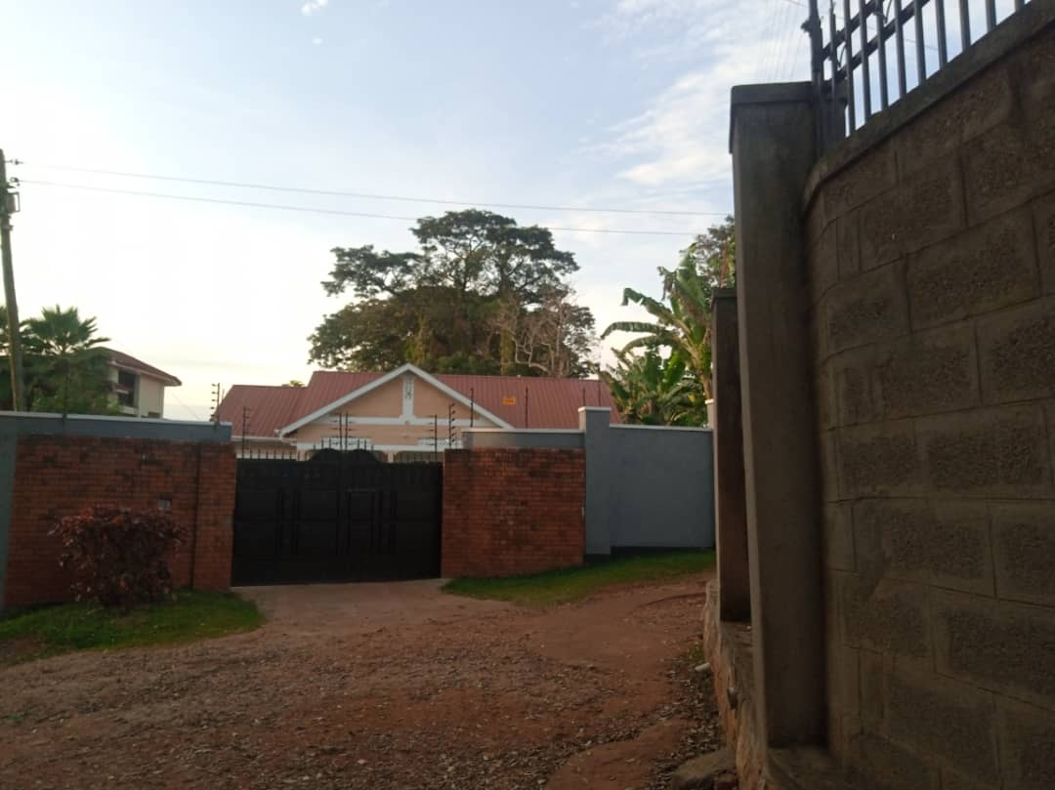

Slide 10
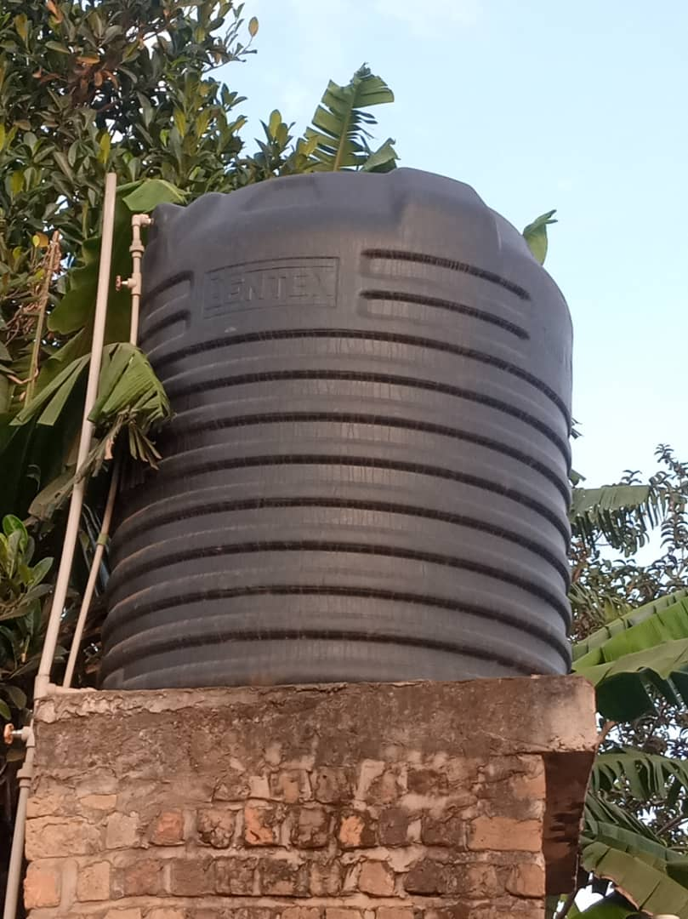
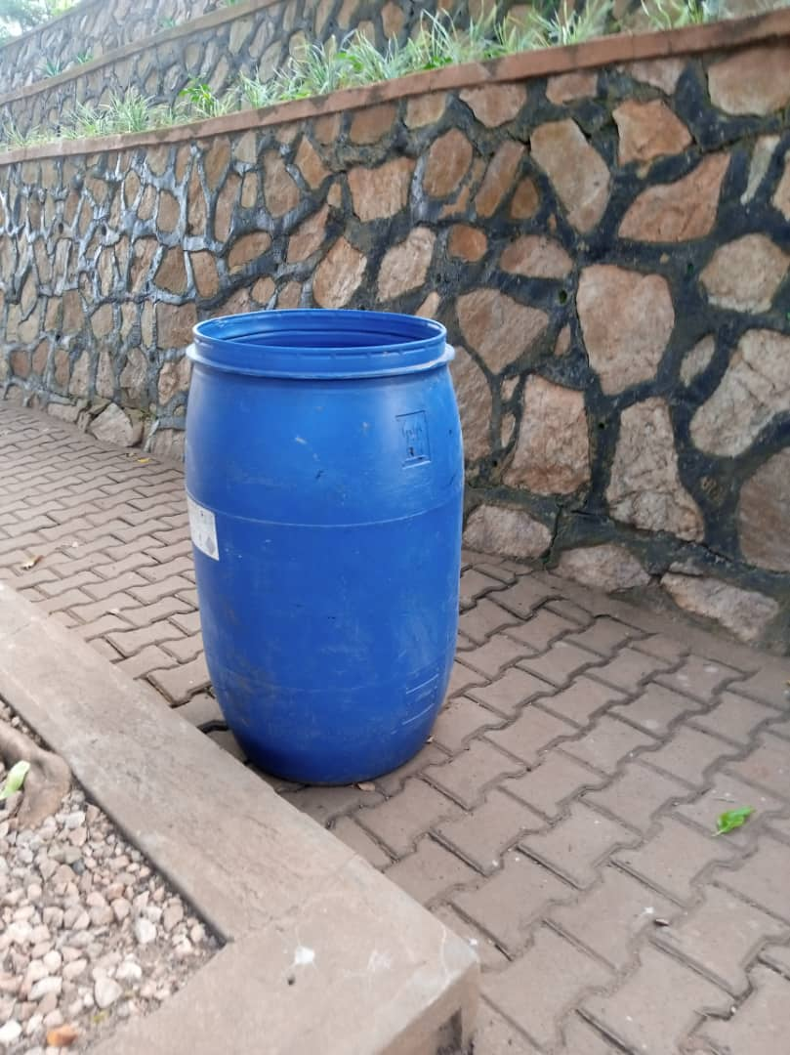
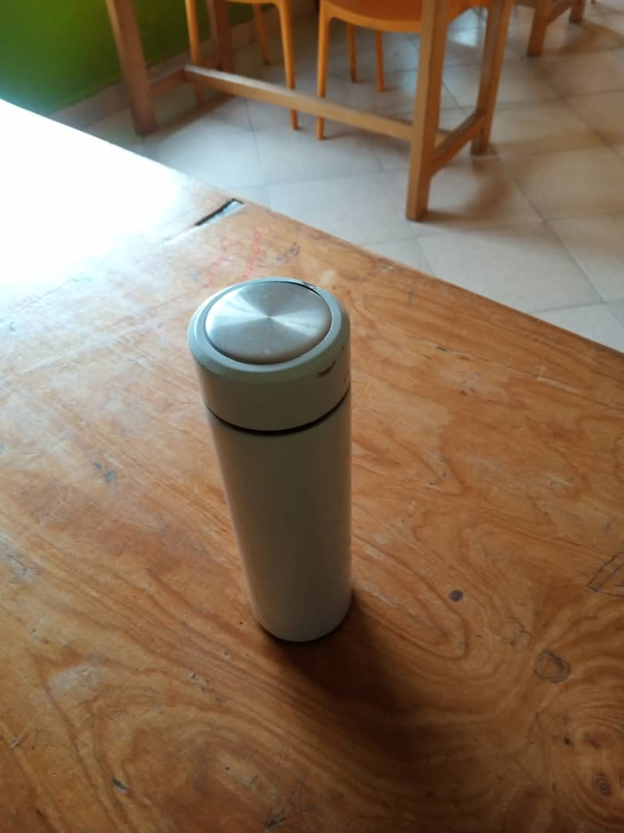
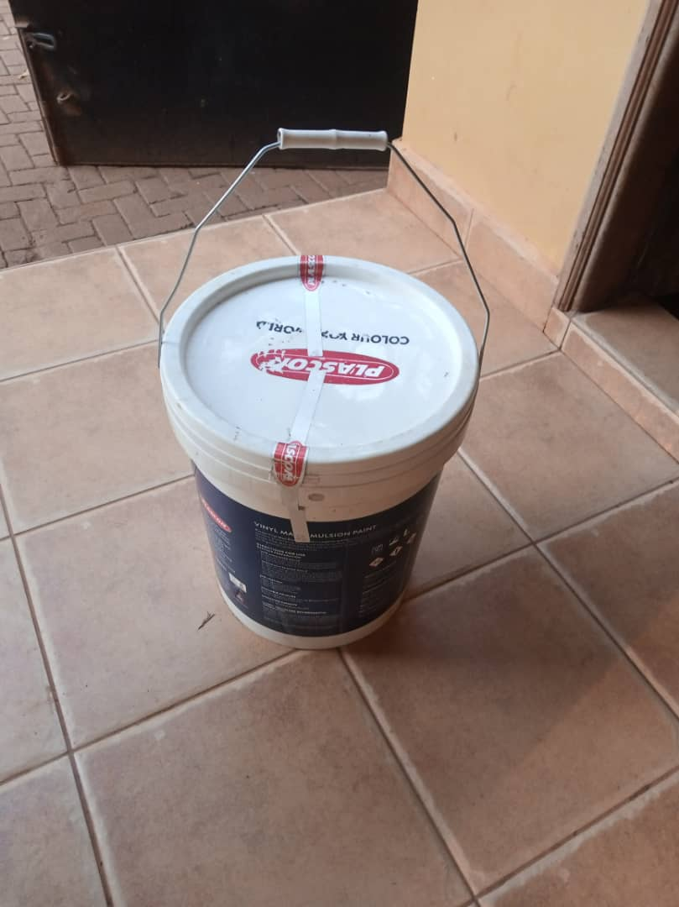

Slide 11
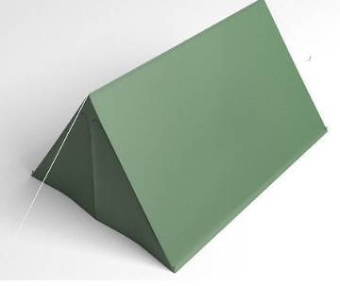
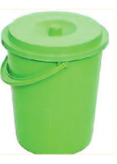
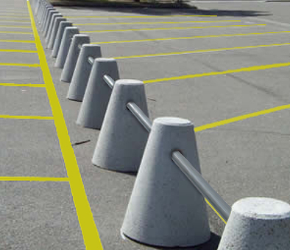

Slide 12
MUST KNOW SHAPES
2- D shapes
3- D shapes
Square
Rectangle
Circle
Triangle
etc
Cuboid
Cube
Cylinder
Cone
etc

Slide 13
NOTE
Dos
Don’ts
Define and be coherent
Units
Write a formula Where necessary
Conclude with words and evidence
Pythagoras theorem at your figure tips
Volume and Area formulas
Trigonometry basics.
Avoid pre mature approximations
Don’t mix units
Don’t cram a formula

Slide 14
Basic Concepts about Frustum
Frustum: solid figure formed by slicing the tip of a pyramid or a cone with a plane parallel to the base
NOTE
1 litre = 1000 cm³

Slide 15
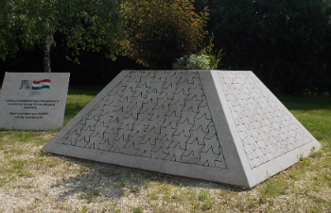
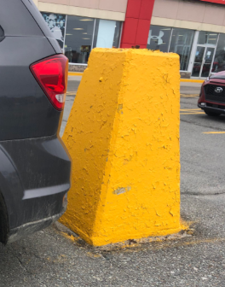
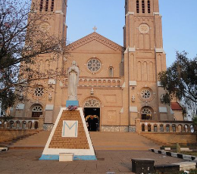
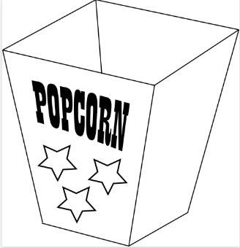

Slide 16
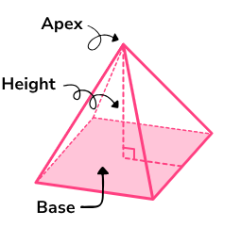
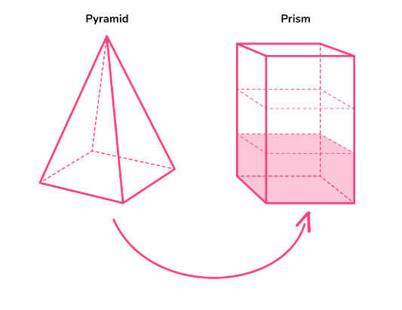

Slide 17
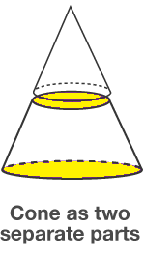
NOTE
1 litre = 1000 cm³

Slide 18
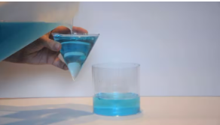

Slide 19
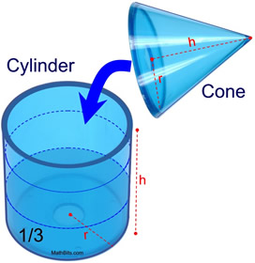
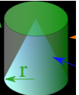

Slide 20
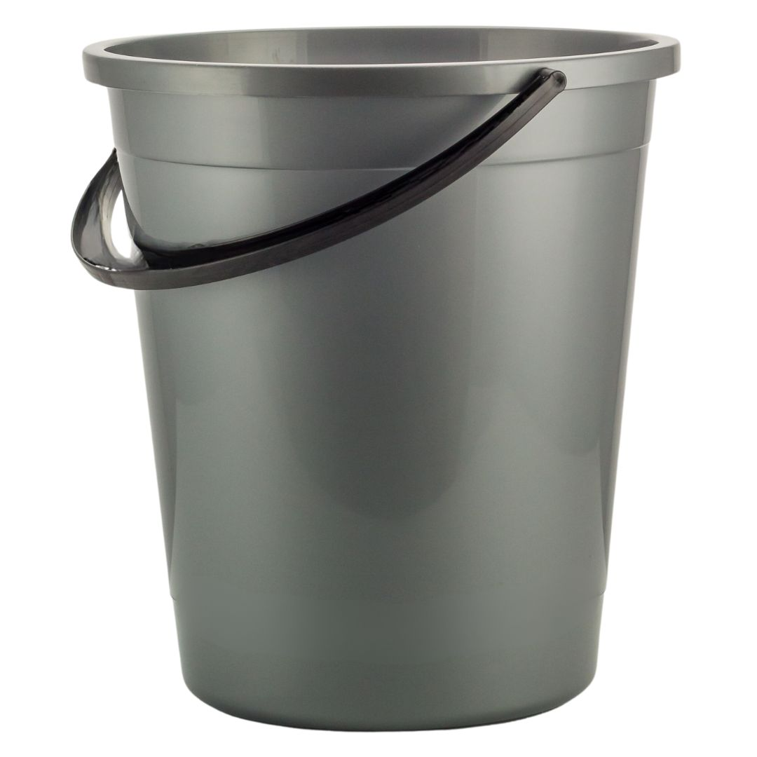
Item
Christopher is a man in the village who fetches water using a bicycle to earn a living .He uses his bucket of height 63cm ,bottom diameter of 30cm and top diameter of 48cm.Your family is organizing a party and Christopher has been contacted to fetch water. He has to fill the 500 litre tank. If he is paid UGX 2000 per bucket. What should the family budget for to cater for Christopher's task.
48cm
63cm
30cm

Slide 27
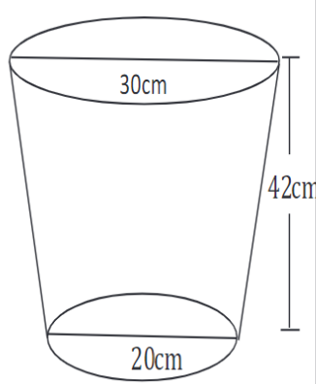
Activity
A bucket is in shape of a frustum with an open end of diameter 30cm and a bottom diameter of 20cm. The bucket which is 42cm deep is used to fill an empty cylindrical tank of diameter 2.0m and Height 1.0m
Three hundred and sixty litres of a homogeneous paint is made by mixing three paints A, B and C. The ratio by amount of paint A to paint B is 3:2 and that of B to C is 1:2. Paint A costs sh18,000 per litre paint B costs sh24,000 per litre and paint C sh12,750 per litre
Task:
(a)(i) Determine the capacity of the bucket in litres.
(ii) The number of buckets that must be drawn to fill the tank.
(b) (i). The amount of money needed to make 1 litre of the mixture
(ii).The percentage profit made by selling the mixture at sh2,210 per litre.

Slide 28
Activity

Slide 34
PART 2

Slide 35
Activity
Mr. Thomas plans to build a small house next to his main house where he can always rest from in his free time. The house is to have sides in form of a cuboid with dimensions 12m by 8m by 4m and a pyramidal roof. The house is to have three windows of dimensions 0.9m by 0.6m and one door of dimensions 2.1m by 0.8m. He plans to paint the outer walls of the house using 1 litre tin paint and each tin costs Ugx 15,000. A tin can paint 5m2
a (i) Help Mr. Thomas to know the space /area of the wall to be painted.
(ii) Does Mr.Thomas have enough paint for the outer walls
b) How much money will he spend on paint for the whole house.

Slide 38
Activity
A family decides to paint the inner walls of its living room for New Year celebrations with a budget of Shs 400,000. The room is 5m long, 4m wide and 3m high. The room has two painted doors in the middle of the walls opposite to each other. Each door is 2m high and 0.75m wide. The room has one painted window in one of the side walls which is 1m square. A painter charges Shs 800 per square meter painted and for every 10m square wall painted fully, consumes a 4 litre tin paint which he sells at Shs 70,000.
Task:
As a mathematics student;
(i) Establish computations to find out if the budgeted money could be enough for this work.
(ii) If a painter offers a discount of 10% on labour and 5% on every litre of paint. How much money shall the family save?

Slide 43
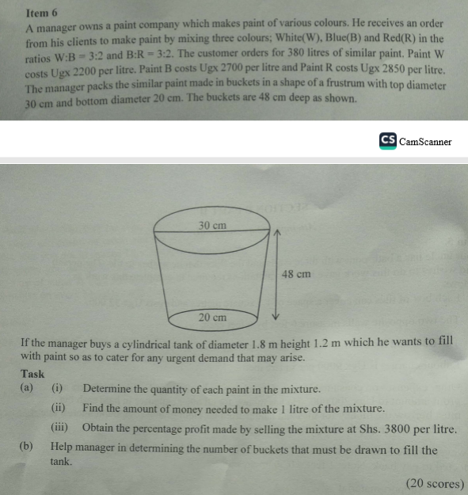

Slide 44
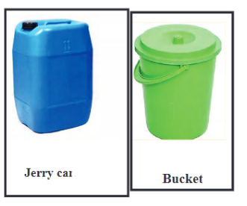
Link Hotel is facing a problem of water supply. The owner has instructed the Hotel Manager to contract any water fetching company to fill the newly bought water tank at the Hotel within a period of not more than three weeks. The company contacted has two systems P and Q to fetch water. In system P, water is fetched using jerry cans and system Q that uses buckets as shown below.
The Hotel tank has a base of diameter 300 cm and height of 4 m and the jerry cans are of dimensions of 25 cm by 30 cm by 60 cm while the buckets each has diameters of 500 mm on top and 300 mm at the bottom plus a height of 450mm.
In a day, the company can only fetch 120 Jerry cans of water under system A or 100 Buckets when uses system B. The cost of water from the Commercial Reservoir is sh10 per litre. The transport charge per Jerrycan is sh500 and sh300 per Bucket. The Hotel uses 600 litres of water on a daily basis. The Hotel management policy requires that the water budget should always be submitted four weeks before the tank becomes empty to avoid any crisis.
The Hotel manager would like to make a budget in order to get money from his boss to facilitate the work but he is uncertain of the suitable system of fetching water to choose and the total amount of money he can request from his boss.
Task
(a) Help the Hotel Manager to make the right decision by choosing the most suitable system of fetching water that meets the requirements of his boss.
(b) With reasons, advise the Manager of the Hotel when exactly he should submit the Water budget to his boss.

